Slide 1
DIAGNOSIS OF GASTRIC CANCER USING MIFNET ALGORITHM
H.DHIVYADHARSHINI – 211418104052
R.DIVYA DHARSHINI – 211418104055
S.KEERTHANA – 211418104118
PROJECT GUIDE: Dr.K.Sangeetha
Associate Professor

Slide 2
INTRODUCTION
Gastric cancer (GC) is one of the most common malignant tumours with poor prognostic results. It remains one of the deadly diseases with poor prognosis.
The worldwide shortage of pathologists offers a unique opportunity for the use of artificial intelligence assistance systems to alleviate the workload and increase diagnostic accuracy.
Endoscopic examination is mainly utilized for early detection, while pathological confirmation and CT scanning are suggested for further treatment.
To overcome this problem, this project develops a method using deep learning algorithms to assist the diagnosis of gastric cancer as it involves numerous tests to arrive at a conclusion.
Thus, this project helps in effective diagnosis of gastric cancer using MIFNET Algorithm with higher accuracy than the existing models.

Slide 3
LITERATURE REVIEW
Shuai Ding (2021) | ID-GCS | It integrates objective medical data and subjective experiential knowledge obtained from gastroscopy reports for GC screening.
Shaolong Shi(2020) | NGA-Inspired Nanorobots | It locates the tumor targets efficiently using Nano Robots.
Efthymios P. Papageorgiou (2020) | CMOS image sensor | Chip-scale fluorescence imaging ASIC that uses ASGs to enhance image resolution.
Jean-S´ebastien Boisvert,(2020) | Three modes, namely the Ω , γ and RF plasma jet mode. | The light distribution between the electrodes is measured with the help of a CCD camera.
Ai-Min Yang, (2020) | TSVR algorithm | They got score of each index by the physical health evaluation of each patients under established the cancer recurrence prediction.
Seungwoo Song,(2019) | Peptide Aptamer-Based Functionalized Microneedle | The sensor system successfully detects the VEGF in both phosphate-buffered saline (PBS) and human blood serum
Chih-Hung Chan(2019) | Branch-Collaborative Network for Oral Cancer Detection | It can be used as the input data to the deep convolutional network model.
Bo Fu; Pei Liu(2019) | (iDFS) ,MP4Ei, XGBoost algorithm. | It could be used in clinical practice to predict patient’s prognosis and future surviving state.
Man-Sun Kim (2019) | Linear mixed-effect regression model (LMER) | To find specific gene expression changes according to cancer stage.
SeongRyeol Moon(2018) | TP53 Missense Mutations In Gastric Cancer | Patients having mutations at R248 showed poorer survival than other patients having mutations at different TP53 positions.

Slide 4
PROBLEM STATEMENT
The traditional diagnosis of cancer images, relying on pathologists’ visual observation, is time-consuming and labor-intensive.
To develop a method using deep learning algorithms to assist the diagnosis of gastric cancer.
To diagnose the presence of cancer more accurately using advanced algorithm such as MIFNET
To help in effective diagnosis of gastric cancer with higher accuracy

Slide 5
DEVELOPMENT ENVIRONMENT
HARDWARE REQUIREMENT
PC
RAM : 8 GB
Processor : i5
Hard disk : 1 TB
Speed : 3 GHz
Key Board : Standard Windows Keyboard
SOFTWARE REQUIREMENT
Google Colab
Python
Annotation tool
Visual studio code

Slide 6
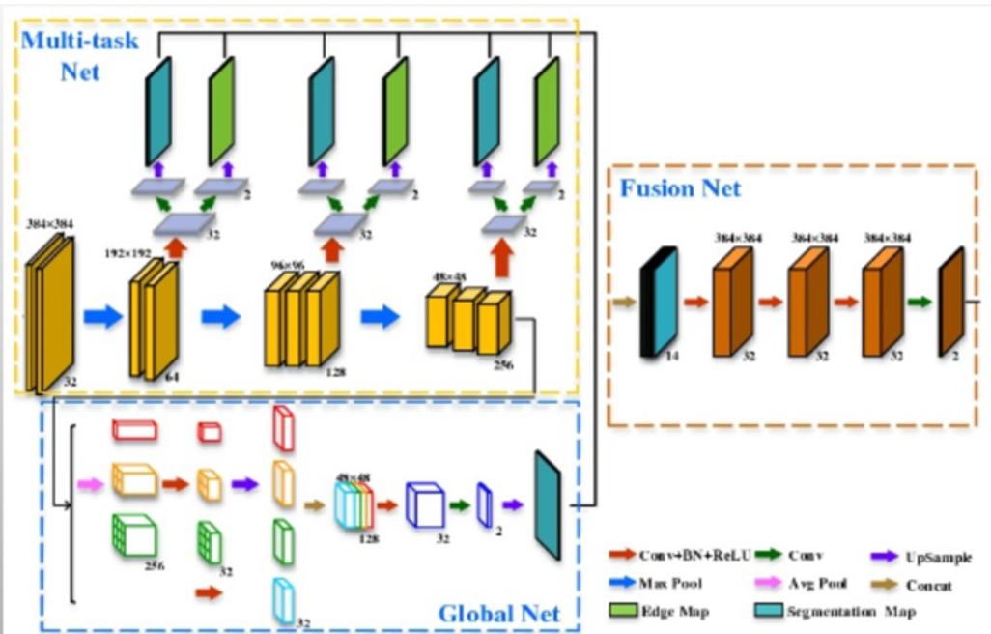
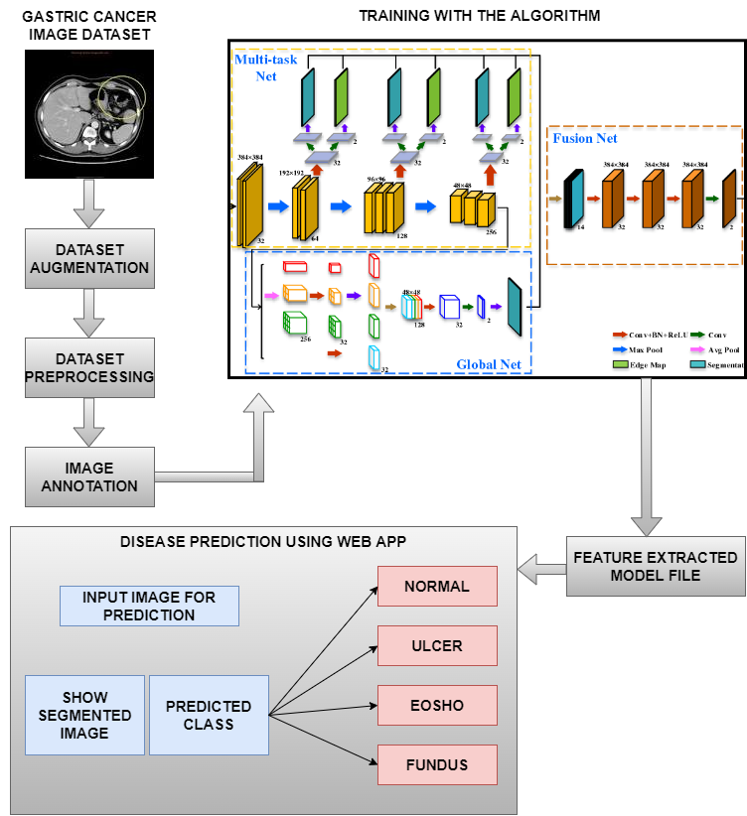
SYSTEM ARCHITECTURE
ANNOTATION TOOL

Slide 7
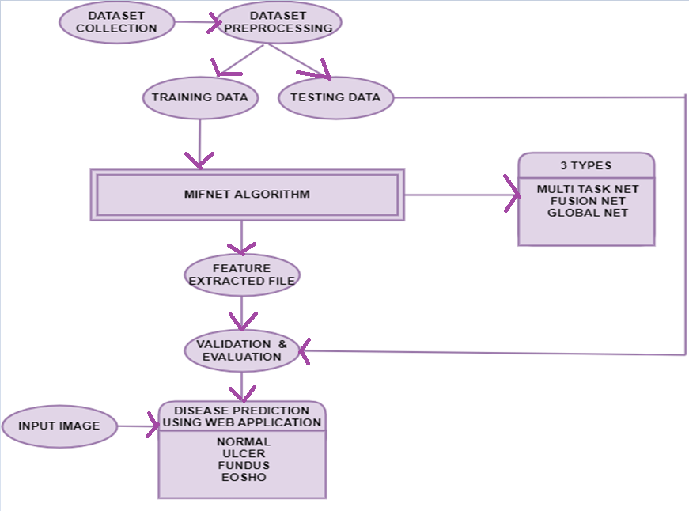
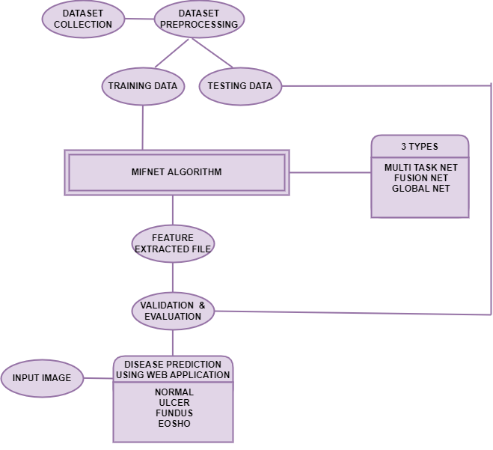
ER DIAGRAM

Slide 8
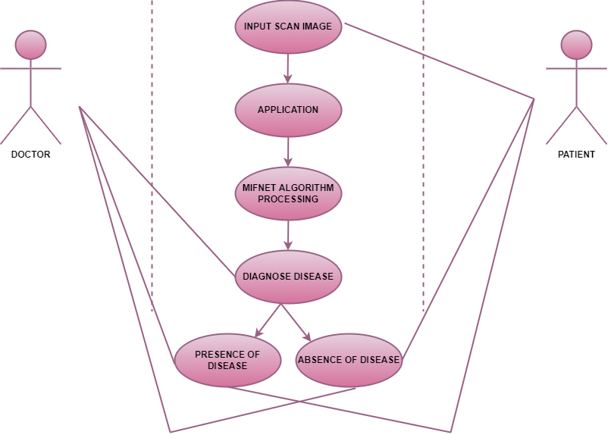
USECASE DIAGRAM

Slide 9
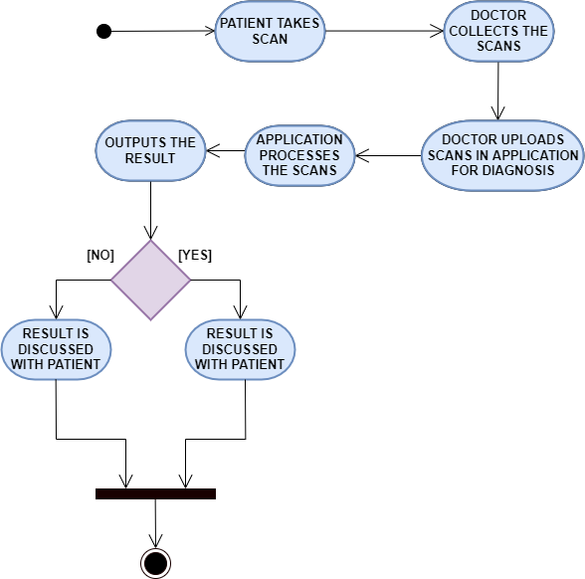
ACTIVITY DIAGRAM

Slide 10
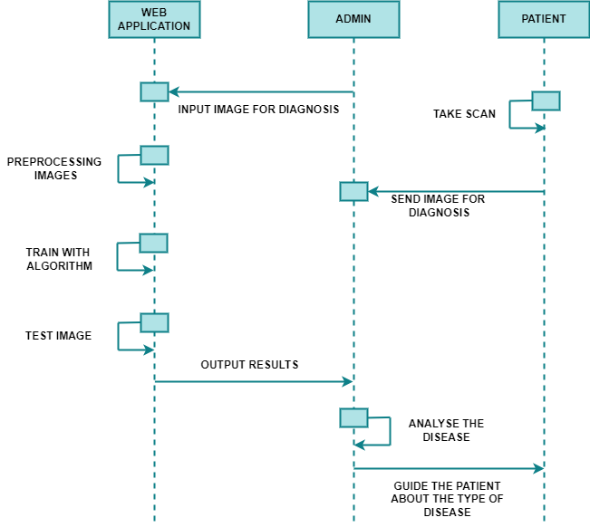
SEQUENCE DIAGRAM

Slide 11
MODULES DESCRIPTION
Gastric Cancer Dataset Collection
Dataset Preprocessing
Annotating Images
MIFNET Algorithm training
Validation and Evaluation
Disease Prediction
Web application

Slide 12
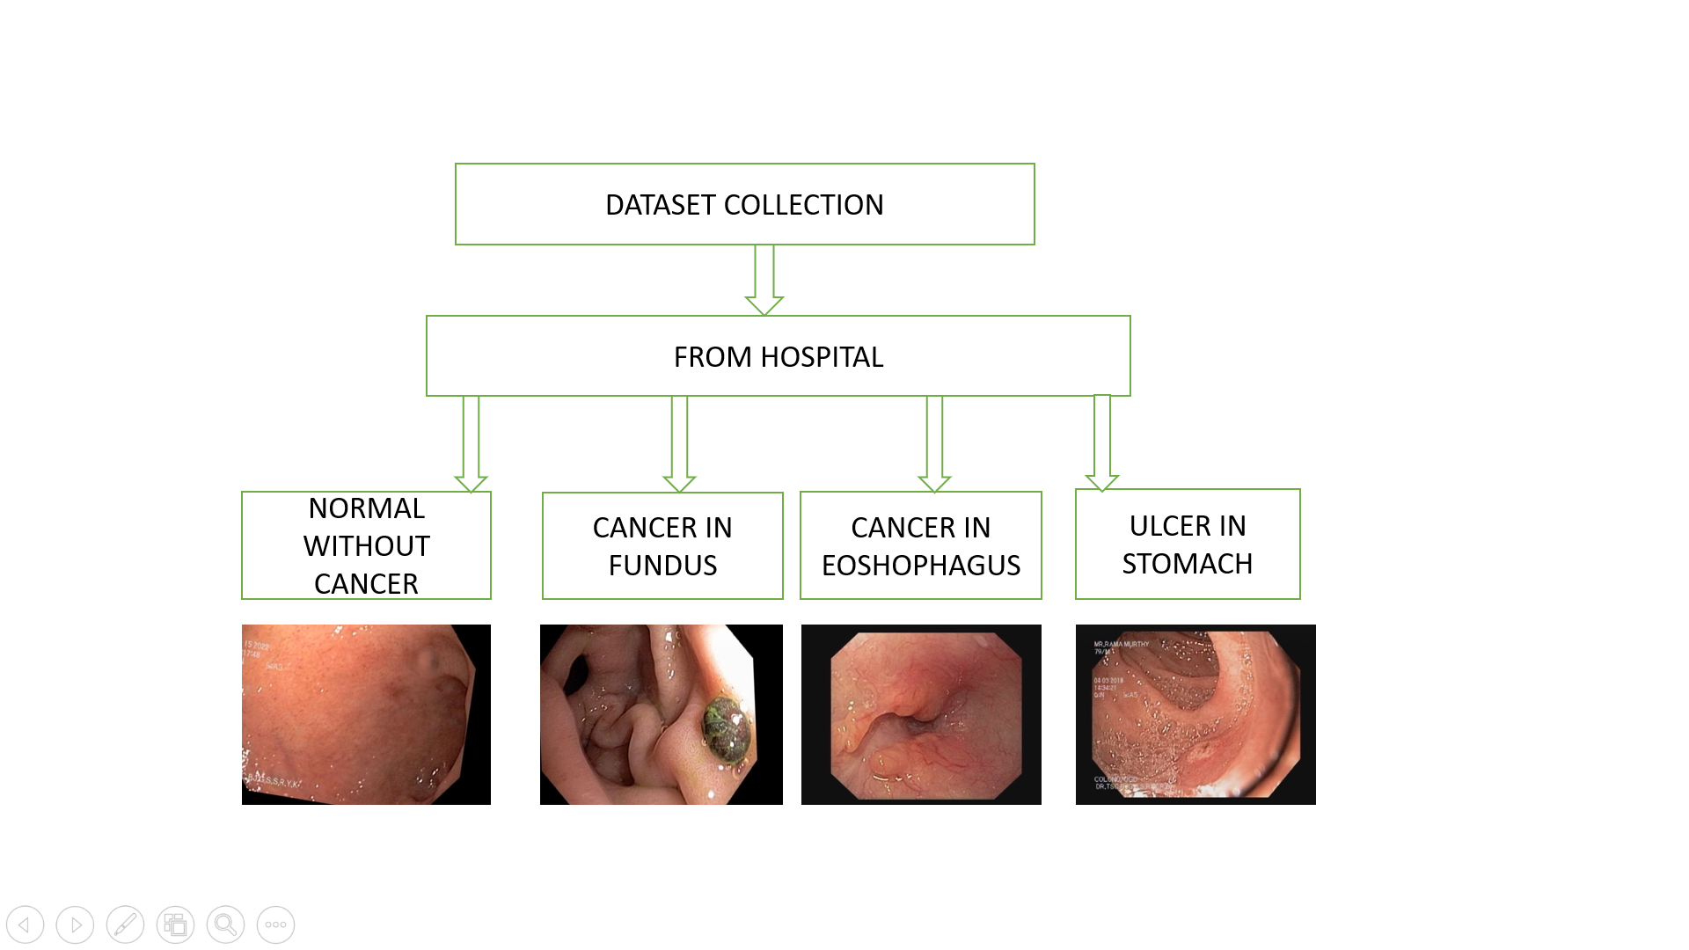
GASTRIC CANCER DATASET COLLECTION

Slide 13
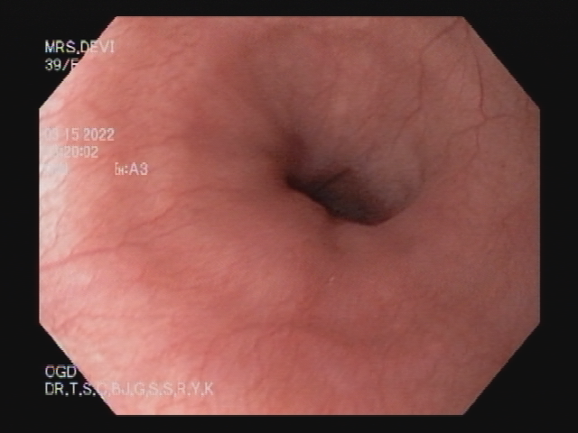
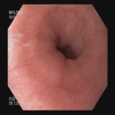
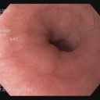
DATA PREPROCESSING
Simple pre-processing- Input
Random Size
Aspect aware pre-processing- Input
Edges are cut
Size is reduced
OUTPUT
128 * 128 preprocessed
OUTPUT
128 * 128 preprocessed

Slide 14
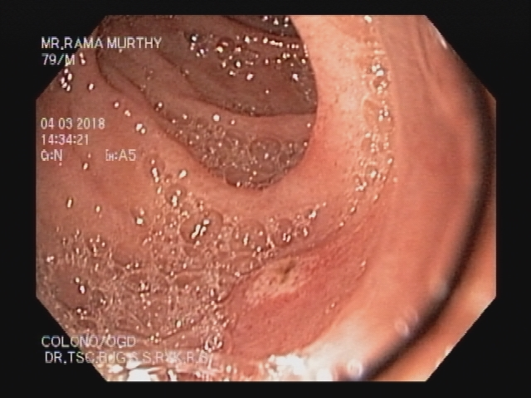

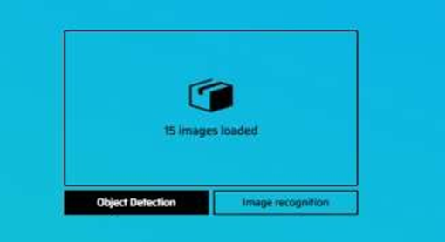
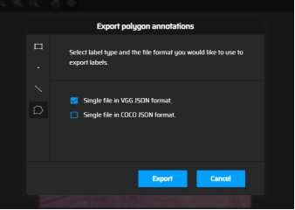
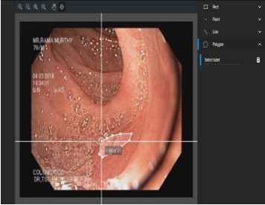
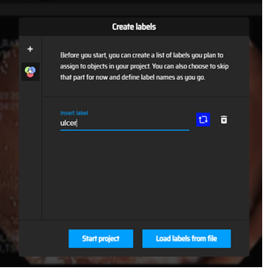
ANNOTATING IMAGES
INPUT IMAGE
ANNOTATION TOOL
OBJECT DETECTION
JSON FILE FORMAT
SEGMENT ROI
CREATE LABELS

Slide 15
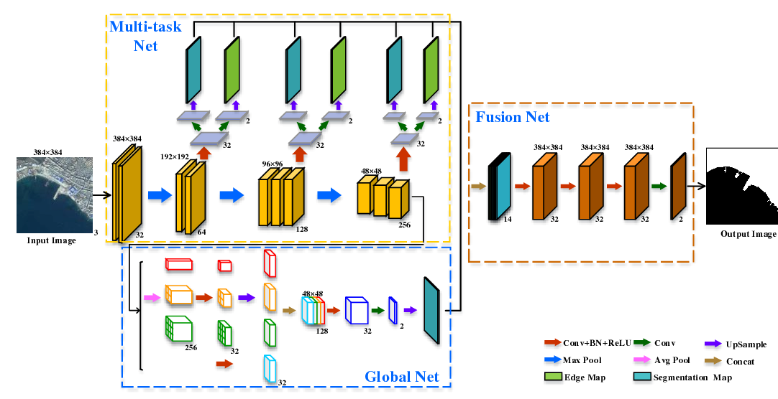
MIFNET ALGORITHM TRAINING PROCESS

Slide 16
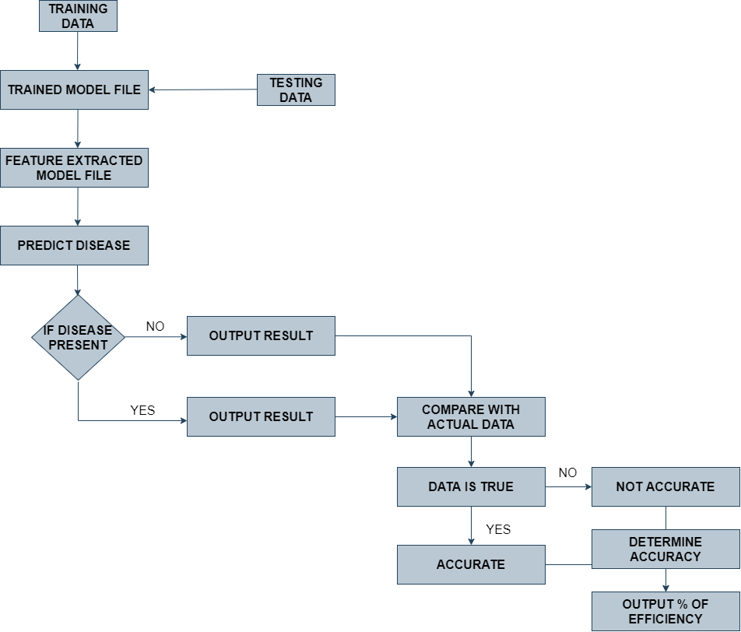
VALIDATION AND EVALUATION PROCESS

Slide 17
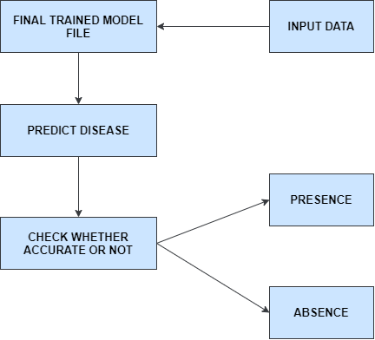
DISEASE PREDICTION PROCESS

Slide 18
WEB APPLICATION
In this project we have used React.js which is a java script library for developing user interface.
React is a JavaScript library for building user interfaces. React is used to build single-page applications. React allows us to create reusable UI components.
Login page is created in which user name, password and URL field is mentioned.
The user has to give the username, password and the URL obtained in the backend coding developed in python.
After that a page is directed where the user can choose the image from the system which has to be predicted.
Then a submit button should be clicked after which it displays the output.

Slide 19
PERFORMANCE ANALYSIS
 | Precision | Recall | F1-score | Support
Esophagus | 0.94 | 1.00 | 0.97 | 16
Fundus | 1.00 | 0.91 | 0.95 | 11
Normal | 1.00 | 1.00 | 1.00 | 12
Ulcer | 1.00 | 1.00 | 1.00 | 11
Accuracy |  |  | 0.98 | 50
Macro average | 0.99 | 0.98 | 0.98 | 50
Weighted average | 0.98 | 0.98 | 0.98 | 50

Slide 20
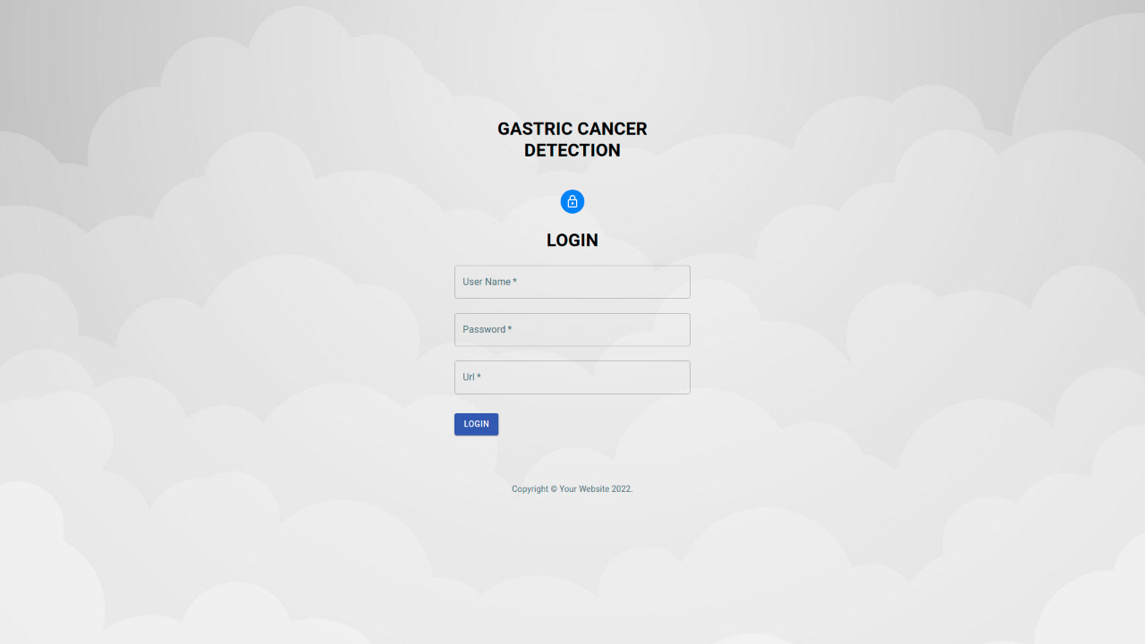
SCREEN SHOTS
LOGIN PAGE

Slide 21
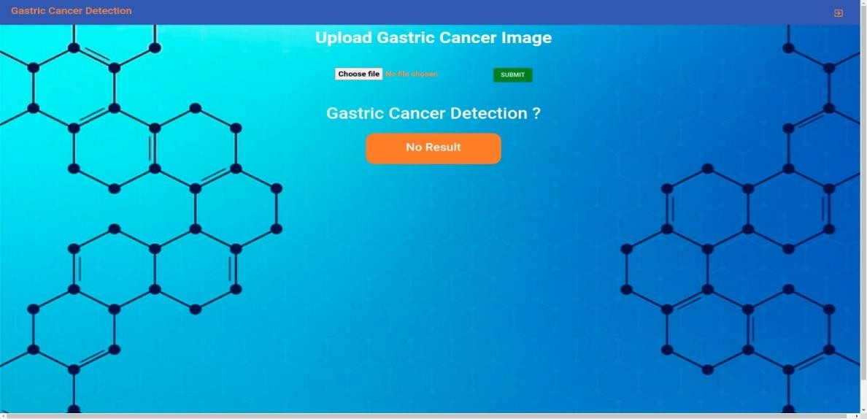
SCREEN SHOTS
HOME PAGE

Slide 22
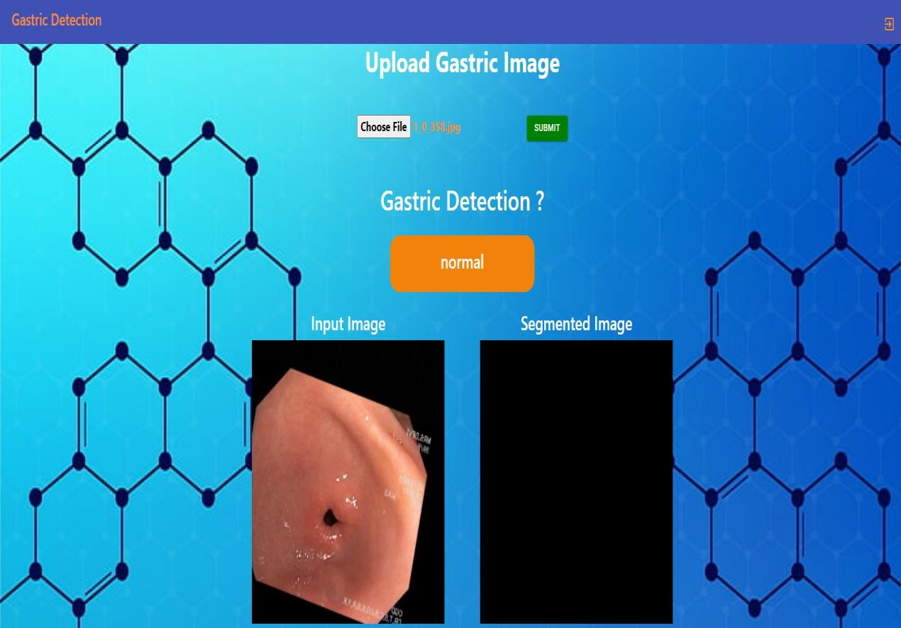
SCREEN SHOTS
NORMAL

Slide 23
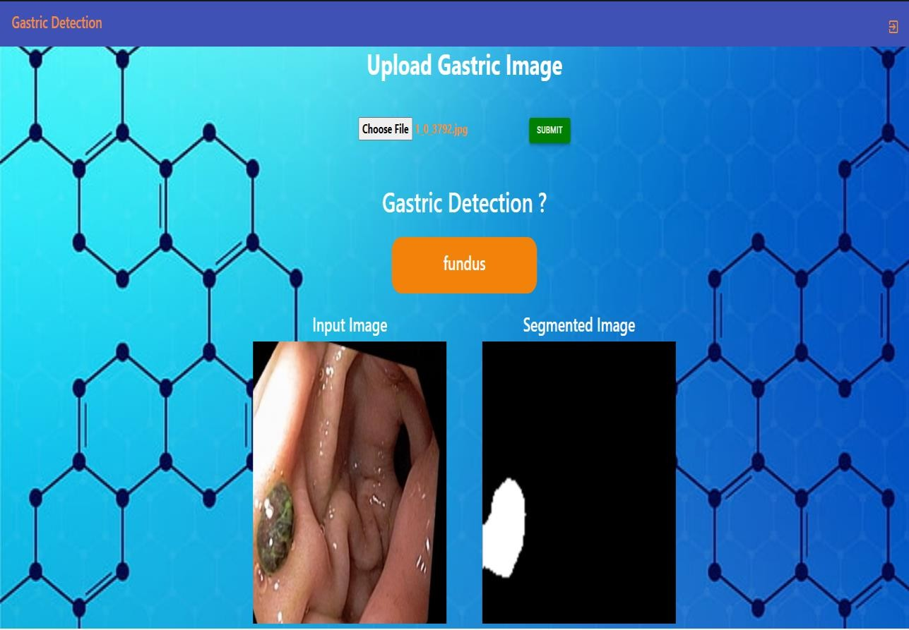
SCREEN SHOTS
CANCER IN FUNDUS

Slide 24
CONCLUSION
The project has been successfully implemented to predict the presence of the disease and determine whether the person has affected with cancer in esophagus, fundus or has cancerous ulcer and provide prior measures to avoid the disease.
Dataset is collected from hospital having with and without cancer. Then image annotations are performed using make sense AI which are exported as JSON format.
This file is then sent to next implementation procedure to train the features using deep learning algorithm and so on.
The MIFNET algorithm has helped to achieve an accuracy of 98% which is higher than the existing model.
It can be used in all hospitals, laboratories, test centers.

Slide 25
REFERENCES
[1] Shuai Ding , Member, IEEE, Shikang Hu, Xiaojian Li , Youtao Zhang , Member, IEEE, and Desheng Dash Wu,Senior Member, IEEE,(2021),“Leveraging Multimodal Semantic Fusion for Gastric Cancer Screening via Hierarchical Attention Mechanism”,IEEE Transactions on Systems, Man,and Cybernetics:Systems,Page 1 - 14
DOI: 10.1109/TSMC.2021.3096974
[2] Shaolong Shi , Student Member, IEEE, Yifan Chen , Senior Member, IEEE, and Xin Yao,Fellow, IEEE,(2020)”NGA-Inspired Nanorobots-Assisted Detection of Multifocal Cancer”, IEEE Transactions on Cybernetics, Page 1 - 11
DOI: 10.1109/TCYB.2020.3024868
[3] Efthymios P. Papageorgiou; Bernhard E. Boser; Mekhail Anwar,(2020),” Chip-Scale Angle-Selective Imager for In Vivo Microscopic Cancer Detection”, IEEE Transactions on Biomedical Circuits and Systems, Volume No 14, Page 91 – 103
DOI: 10.1109/TBCAS.2019.2959278
[4] Jean-S´ebastien Boisvert, Julie Lafontaine, Audrey Glory, Sylvain Coulombe and Philip Wong,(2020),” Comparison of three radio-frequency discharge modes on the treatment of breast cancer cells in vitro”, IEEE Transactions on Radiation and Plasma Medical Sciences, Volume No 4, Page 644 - 654
DOI: 10.1109/TRPMS.2020.2994870
[5] Ai-Min Yang, Yang Han, Chen-Shuai Liu, Jian-Hui Wu, Dian-Bo Hua,(2020),” D-TSVR Recurrence Prediction Driven by Medical Big Data in Cancer”, IEEE Transactions on Industrial Informatics, Volume No 17, Page 3508 – 3517
DOI: 10.1109/TII.2020.3011675
[6] Seungwoo Song, Student Member, IEEE, Jukwan Na, MoonHyung Jang, Student Member, IEEE, Hyeyeon Lee, Student Member, IEEE,(2019),” A CMOS VEGF Sensor for Cancer Diagnosis Using a Peptide Aptamer-Based Functionalized Microneedle”,IEEE Transactions on Biomedical Circuits and Systems, Volume No 13, Page 1288 - 1299
DOI: 10.1109/TBCAS.2019.2954846

